Slide 1


EIC General Assembly, 30 September 2020
Measuring implementation process and outcome through NoMAD: What is it, what can it do and how can it be used?
@TracyLFinch
Tracy Finch
Professor of Healthcare & Implementation Science
Faculty of Health & Life Sciences, Northumbria University
Notes:
Summary of talk:
New innovations in health and social care provision promise improvement in service user outcomes, yet fail to be successfully integrated into routine practice. The presentation will provide a brief introduction to ‘implementation science’ and outline how the theoretical and practical developments in this field can help us to better understand – and influence – efforts to create and sustain change in practice. One key approach within the field, Normalization Process Theory (NPT) (http://normalizationprocess.org) will be described and illustrated with brief examples, as a tool for planning and evaluating complex health interventions.

Slide 2






Slide 3
Implementation outcomes: A multifaceted concept
Implementation, by which we mean the social organization of bringing a practice or practices into action.
Embedding, by which we mean the processes through which a practice or practices become, (or do not become), routinely incorporated in everyday work of individuals and groups.
May C, Mair, F, Finch, T et al. Building an interdisciplinary theory of implementation, embedding, and integration: the development of normalization process theory. Implementation Science 2009, 4.

Slide 4
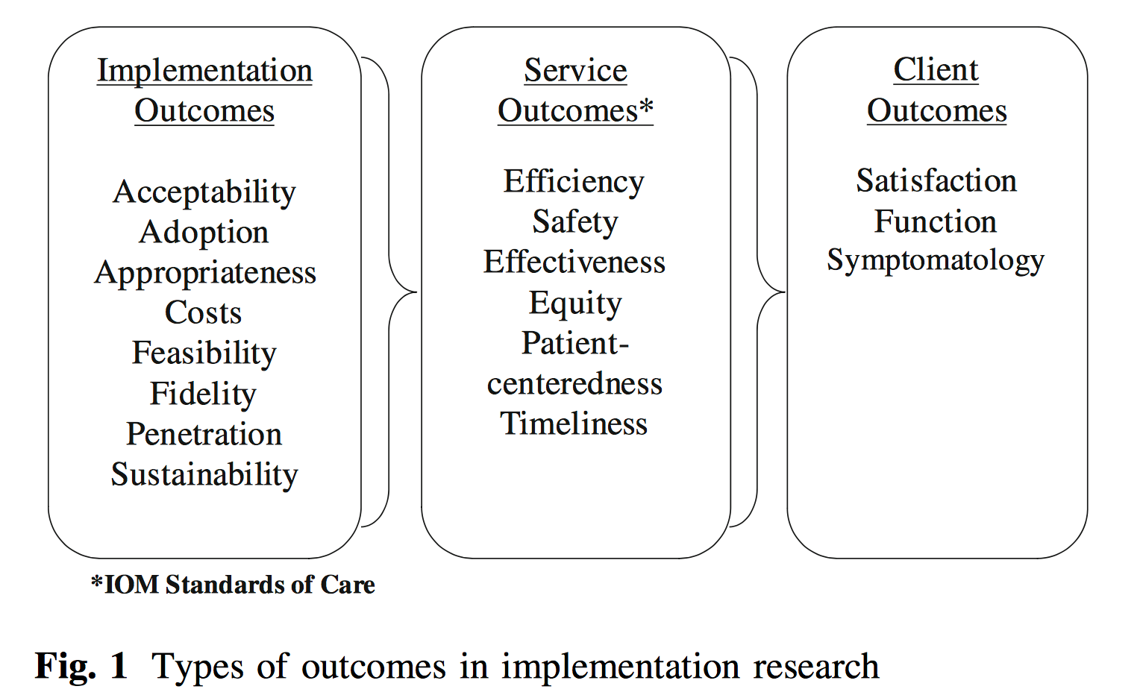
Implementation outcomes: Proctor’s taxonomy
Enola Proctor, et al. Outcomes for implementation research: conceptual distinctions,
measurement challenges, and research agenda. Policy Ment Health. 2011 Mar;38(2):65-76.

Slide 5
Implementation: Can we measure it?
Lewis et al (2015):
104 instruments measuring 8 implementation outcome ‘constructs’:
  Acceptability (n = 50), adoption (n=19), appropriateness, cost, feasibility, fidelity, penetration, sustainability
Lewis, C. C., Fischer, S., Weiner, B. J., Stanick, C., Kim, M., & Martinez, R. G. (2015). Outcomes for implementation science: an enhanced systematic review of instruments using evidence-based rating criteria. Implement Sci, 10.
Notes:
5
Style: one bullet point appearing at a time

Slide 6
Another approach to implementation outcomes: Normalization Process Theory (NPT)
“By normalization, we mean the work that actors do as they engage with some ensemble of activities (that may include new or changed ways of thinking, acting, and organizing) and by which means it becomes routinely embedded in the matrices of already existing, socially patterned, knowledge and practices.”
May & Finch. Implementing, embedding, and integrating practices: an outline of normalization process theory. Sociology 2009, 43(3):535-554.

Slide 7
Outcomes or processes?
In research terms: ‘outcomes’ defined in relation to study time scales and objectives
In practice: ‘end points’ difficult to identify – more likely a ‘process’
I suggest: Measures likely to be used for both purposes

Slide 8
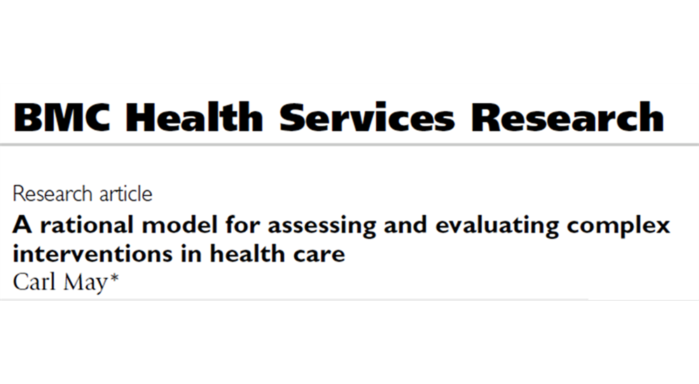


Normalization Process Theory: NPT
Notes:
8
Style: one bullet point appearing at a time

Slide 9
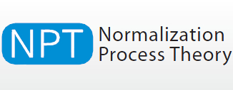

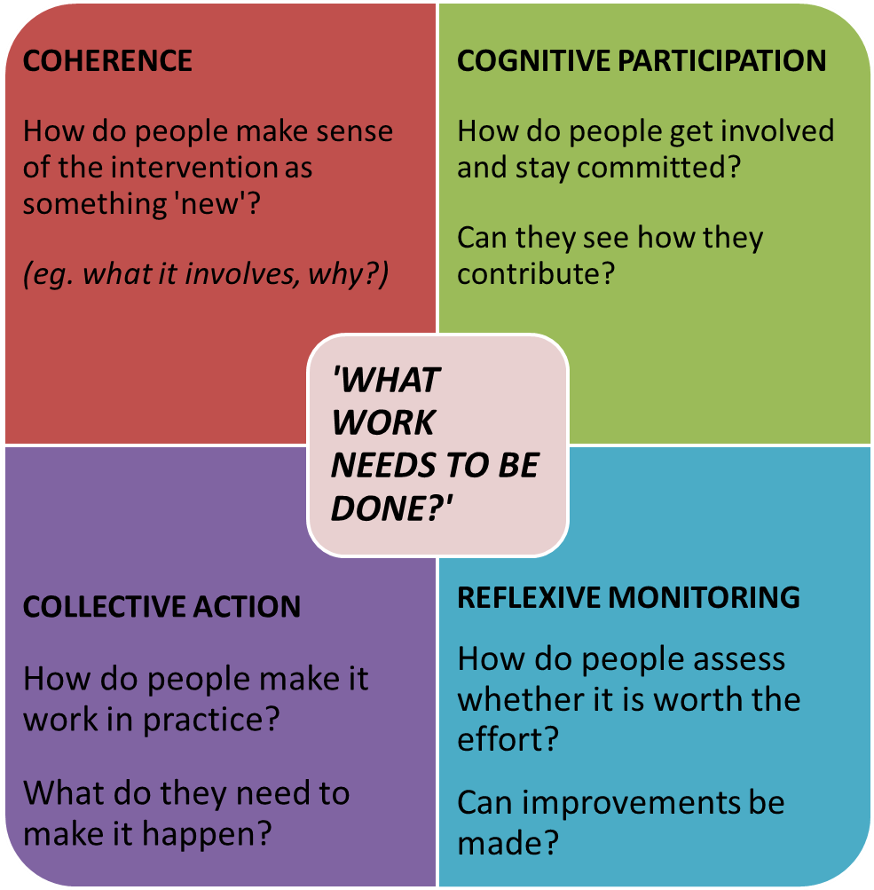
What is NPT?
A way of thinking about implementation problems that focuses on:
How interventions can become part of everyday practice
How different groups of people need to work together to achieve it
How do I use it?
Thinking of your intervention, use the four sets of questions on the right to identify possible barriers to successful implementation, and suggest solutions to improve the process.
www.normalizationprocess.org

Slide 10
Or more simply….
  ‘It’s all about the ‘work’’:
  What is it? (Coherence)
  Who does it? (Cognitive Participation)
  How does it get done? (Collective Action)
  Why did it happen like that? (Reflexive Monitoring)
Notes:
10
Style: one bullet point appearing at a time

Slide 11
What does NPT tell us about implementing and sustaining change?
Implementation work is complex and involves ongoing efforts to achieve sustainable change through building understanding of the work, establishing and maintaining the participation of key persons, and ensuring that participants/organisations have the means of appraising and adapting (where necessary) the work that has to be done.

Slide 12
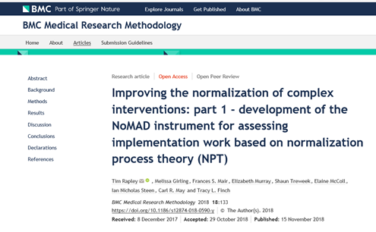
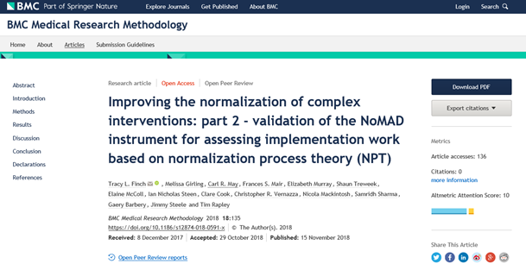

NoMAD
NoMAD study – ESRC RES-062-23-3274

Slide 13
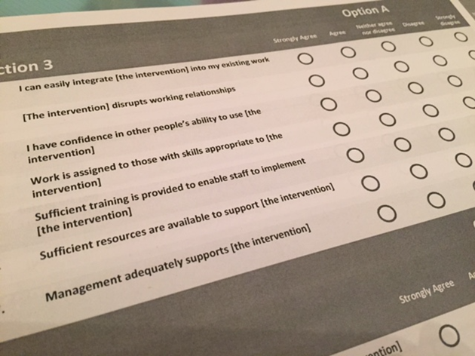
NPT for measurement in research:
Why survey tools?
To compare
  Sites, interventions, professional groups, etc
To quantify
  Implementation progress, change over time, etc
To increase
  Utility of NPT for practitioners and researchers
Notes:
13
Style: one bullet point appearing at a time

Slide 14


Conceptual Development
Online Toolkit
(16 items)
Conceptual and methodological discussion
Review of the literature
Initial Item Generation
(112 items)
Item Development
NoMAD Study
Methods
Item Reduction Workshop (47 items)
Item Appraisal (QAS-99)
Online Expert Pilot Survey (n=5; 53 items)
Item Testing
Version 1 Cognitive Testing (n=18; 47 items)
Version 4 Final
(43 contruct items, plus 3 general items)
Online Expert Survey (n=23; 52 items)
Version 2 Cognitive Testing (n=9; 53 items)
Validation study: 6 implementation projects (n = 522 useable surveys)
Version 3 Item Revisions (n=3; 53 items)

Slide 15
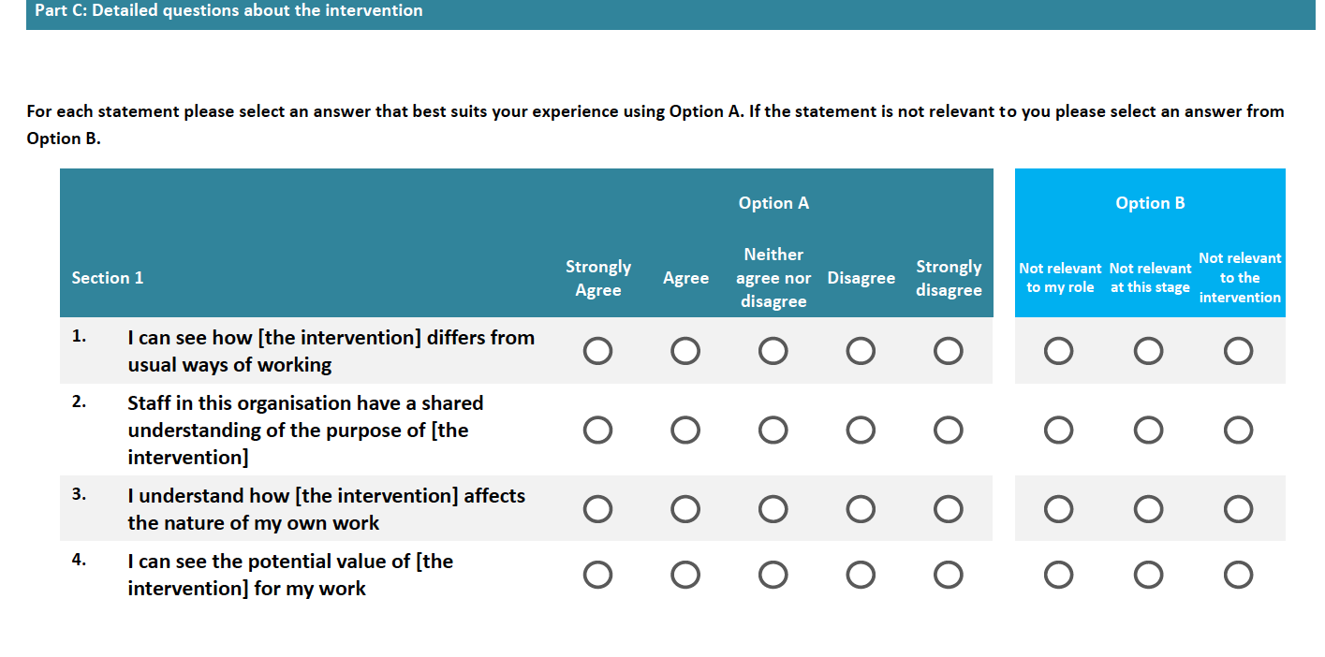

Slide 16
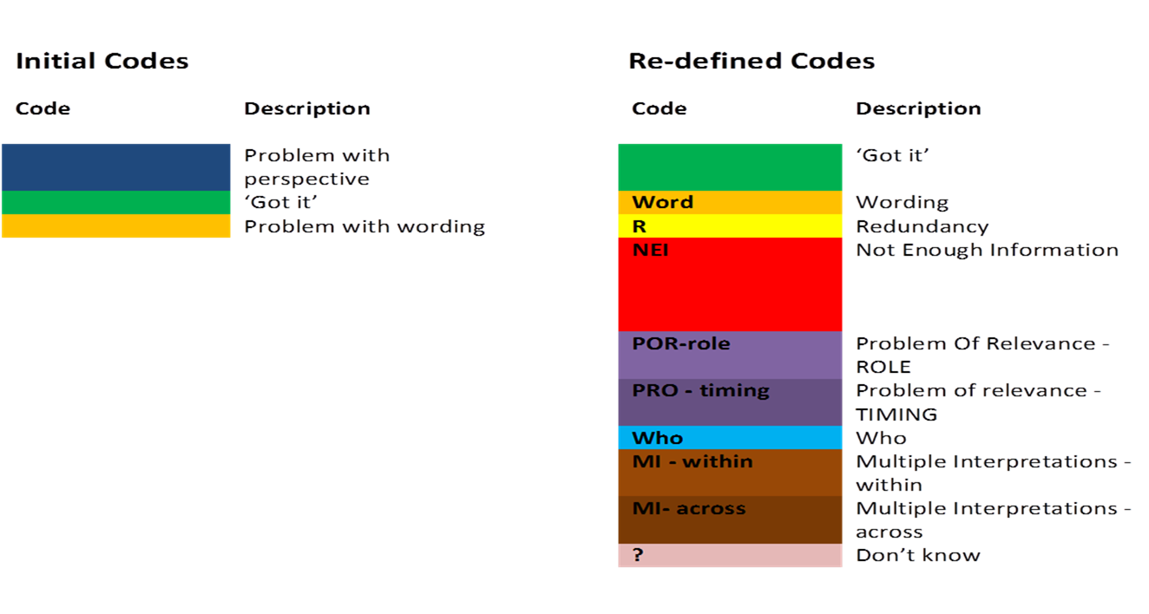
Coding framework

Slide 17
Theoretical translation challenges
Wording/ Ambiguity
The participant queries wording within the item, e.g. unsure of meaning
Timing relevance
The participant does not consider the item ‘relevant’ to the timing of the intervention
Who?
The participant has trouble with ‘who’ the item is relating to e.g. themself, or others (and who the ‘others’ may be)
Multiple Interpretations
The participant offers a response from their own perspective as well as that of others involved in the intervention, in a single response
Role relevance
The participant does not consider the item ‘relevant’ to their role in the intervention
Notes:
17
Style: one bullet point appearing at a time

Slide 18
Validation dataset
Site | Intervention details | Staff involved | N | R R
1 | Digital health record rollout | Health visitors | 67 | 29%
2 | Multi-component intervention for smoking cessation in pregnancy | Midwives; health visitors | 21 | 21%
3 | Implementation of electronic tool designed to support patient self-management | Allied Health Professionals; Consultant and Trainees; GP’s; Nurses and Pharmacists | 91 | 23%
4 | Oral health risk assessment tool/pathway in Dental Hospital | Dentists and Dental students | 229 | 77%
5 | Trust-wide technology implementation involving different occupational groups | Consultants & trainees; Nurse; Admin clerical; Managers; Allied Health professional & Technical services | 87 | 22%
6 | Implementation of sports injury interventions in the AFL | Football coaches & managers | 336 | ??
 | Note: 522 sufficiently completed for pooled analysis | Total responses | 831

Slide 19
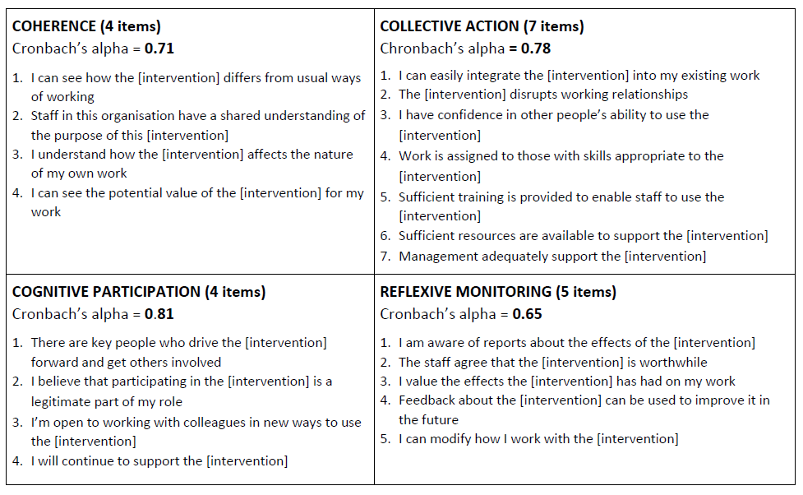
Overall scale = 0.89
Finch TL, Girling, May et al. (2018) Improving the normalization of complex interventions: Part 2 - Validation of the NoMAD survey tool for assessing implementation work based on Normalization Process Theory (NPT), BMC Medical Research Methodology.
Notes:
19
Style: one bullet point appearing at a time

Slide 20
Measuring complexity: standardizing vs adapting
“...implementation scientists might still find it challenging to develop measures of implementation climate that are sufficiently tailored to make them predictive in specific innovation-implementation contexts, yet not so tailored that they could not be used in other innovation-implementation contexts without substantial modification.” (p9)
Weiner, BJ., Belden, CM., Bergmire, DM. & Johnson, M. (2011). The meaning and measurement of implementation climate. Implementation Science, 9:118.
Notes:
20
Style: one bullet point appearing at a time

Slide 21
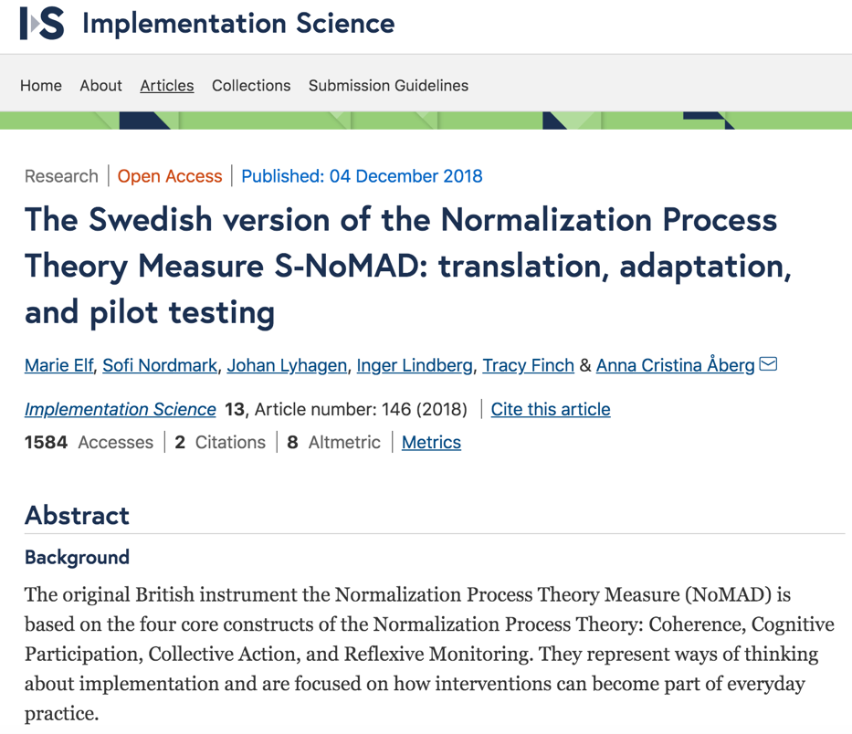


Slide 22
Does it ‘work’ cross culturally?
UK NoMAD | Netherlands NoMAD | Swedish NoMAD
Diverse implementation projects (n = 6) | E-Mental Health | Co-ordinated care planning
N = 522 | N = 313 | N = 144
Poor items: dropped from larger item set using consensus methods | Poor item: The [intervention] disrupts working relationships (CA2) | Poor items: The [intervention] disrupts working relationships (CA2) I have confidence in other people’s ability to use the intervention (CA3) Feedback about the intervention can be used to improve it in the future (RM4)
Psychometrics support 4 construct structure | Psychometrics support 4 construct structure | Psychometrics support structure with poor items removed

Slide 23







Translated NoMADs for ImpleMentAll
Available for use at: www.implementall.eu
European Union’s Horizon 2020 research and
innovation programme under grant agreement No 733025

Slide 24
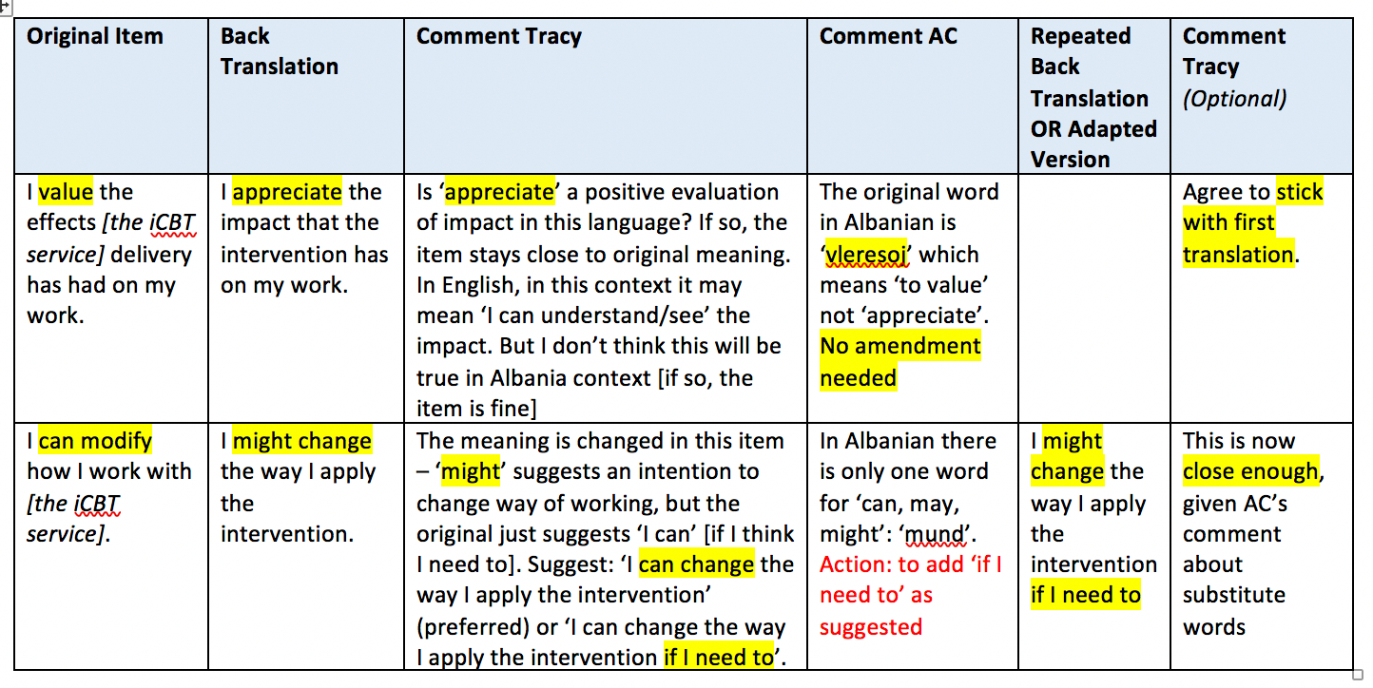

Translation & back translation - Albania

Slide 25
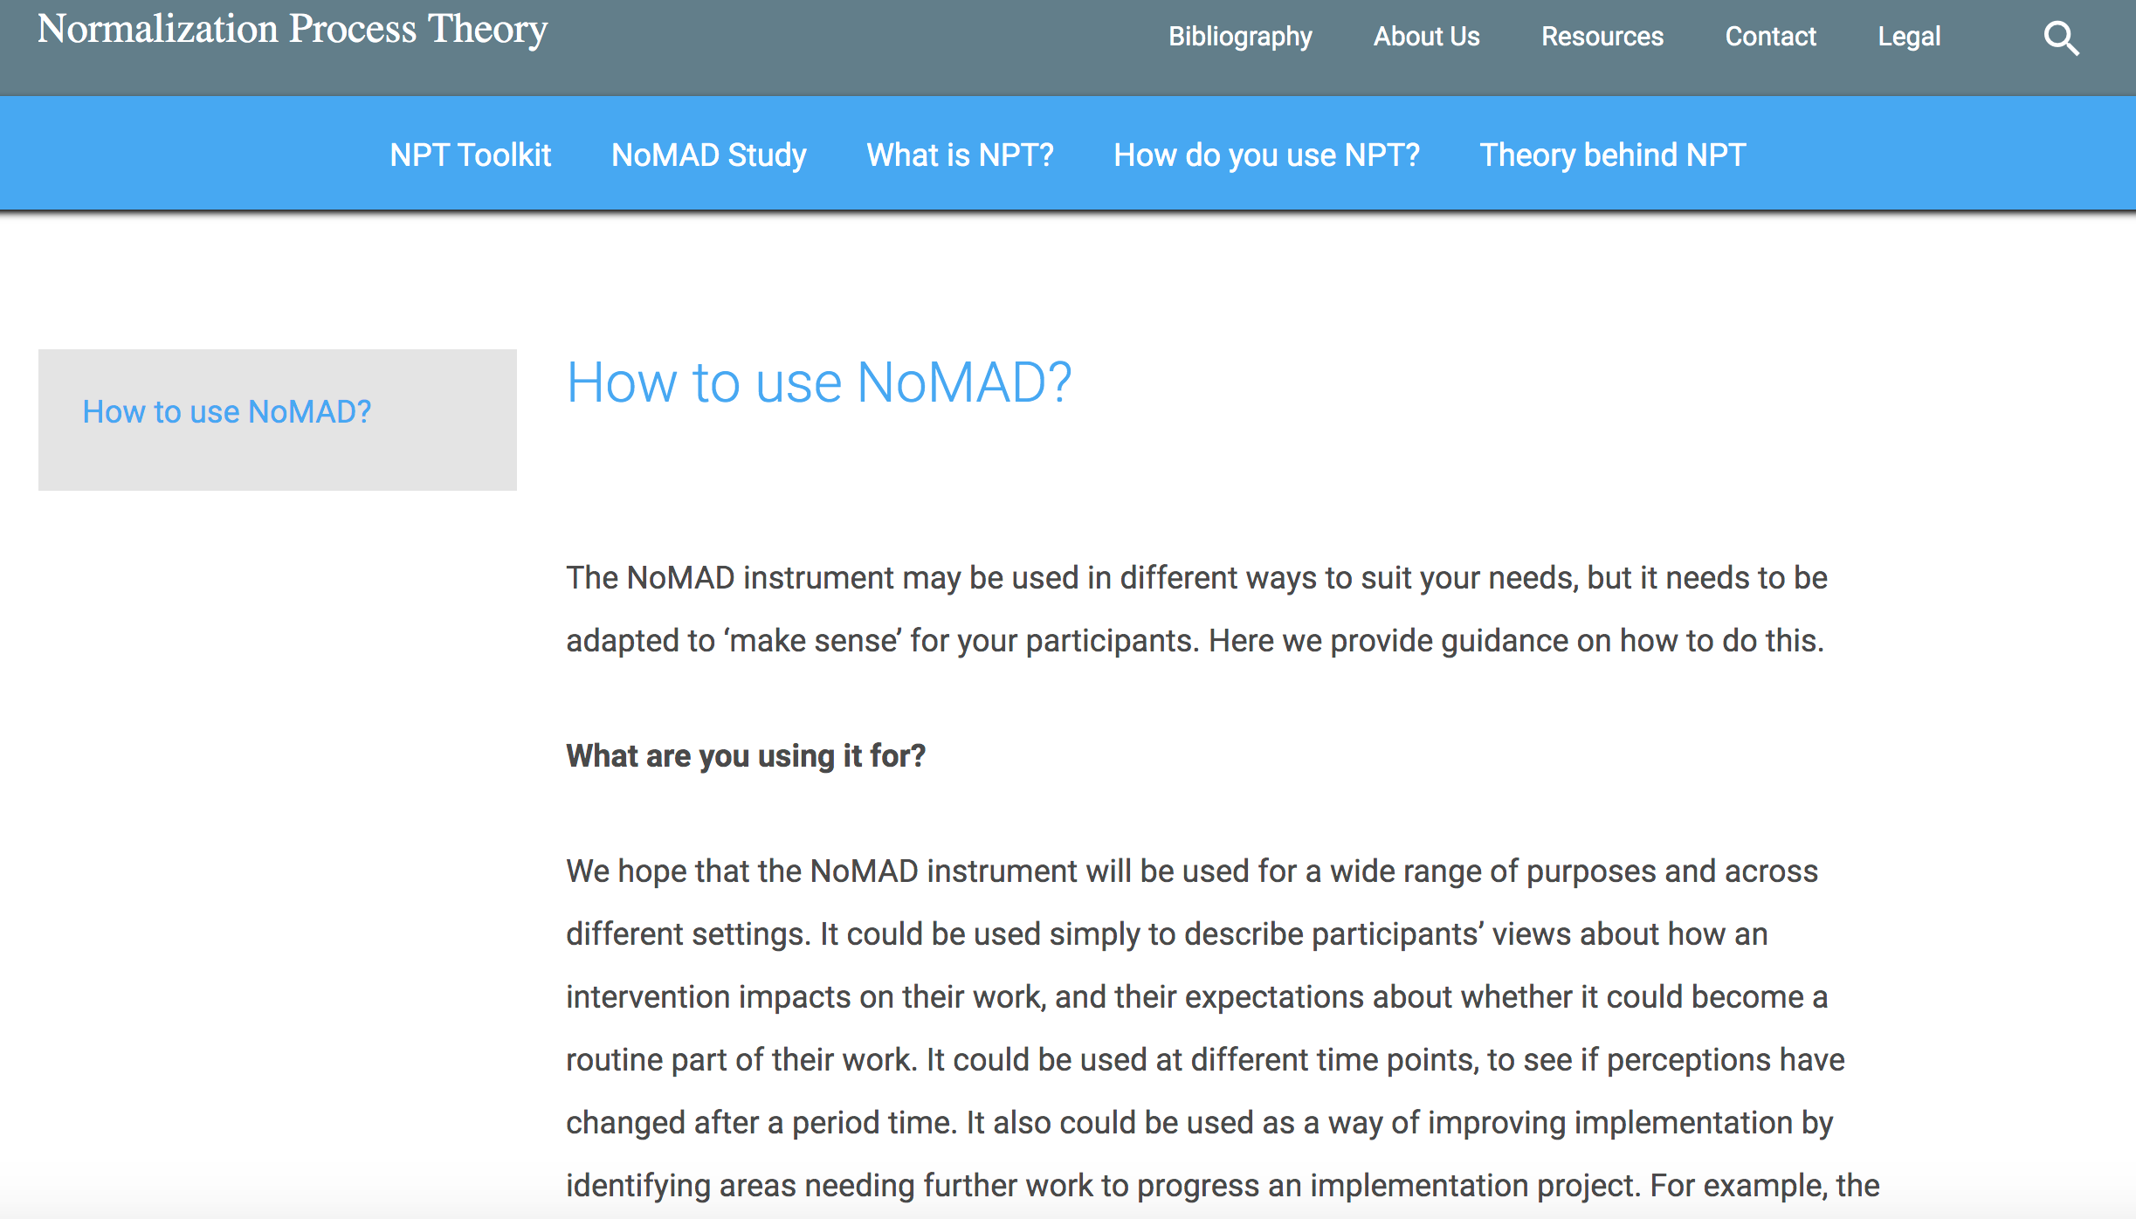
www.normalizationprocess.org

Slide 26
(Possible) Uses of NoMAD
‘Trouble-shooting’ an implementation effort – use survey data to identify potential obstacles and develop solutions
Research studies:
  evaluating the status or outcome of an implementation process
  Assessing progress of an implementation process over time
  Comparing different sites/settings on the implementation of a new practice or process

Slide 27

Mixed methods study informed by NPT
Aim: To understand implementation of AKI alerting on hospital wards
Observations (>44 hours)
Semistructured interviews (n=29)
NoMAD surveys (n=101)

Slide 28

Assessing change over time following intervention
Study of Improvement in Tracheostomy
care across England
Brendan McGrath et al (forthcoming)
Mixed methods: Service quality metrics;
patient outcomes; qualitative interviews with
staff
Timelines: Before, during and after
implementation of Quality Improvement bundles

Slide 29
ImpleMentAll: Evaluating impact of tailored implementation of iCBT on implementation outcomes
@EU_ImpleMentAll
IMA Protocol for evaluation of It-Fits
Effectiveness study
Does using Itfits lead to improved implementation outcomes?
Data: 3-monthly measures (NoMAD/ ORIC)
Cost-efficiency study
Measures of implementation related costs - is it cost-efficient?
Process Evaluation
Toolkit exposure & usage
Descriptive data from online platform
Activities recorded, time spent in modules etc
Qualitative Process Evaluation
Explanatory in-depth study of ItFits toolkit ‘in use’
Evaluation/ description of Implementation as Usual (IAU)

Slide 30
What have we learned about ‘measuring’ using NoMAD?
Implementation work is complex and messy – revealed by ‘think aloud’
Need to think about:
  Roles & participants – the ‘doers’
  Intervention
  Implementation trajectory/stage
Scoring NoMAD – no fixed approach as depends on the study/purpose
To be meaningful/ fit for purpose, tailoring & adaptation is needed

Slide 31
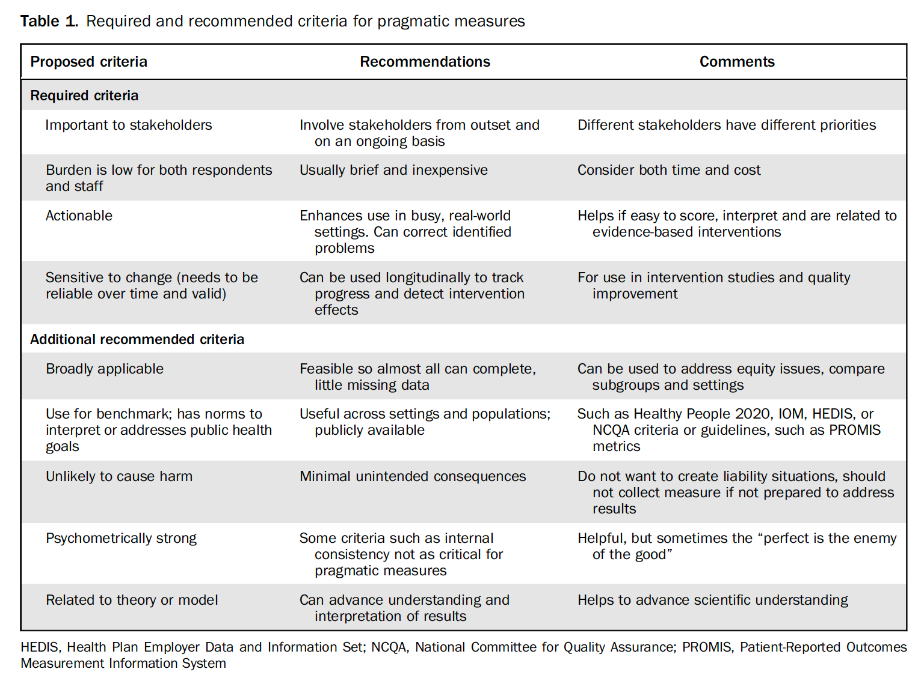
Pragmatic measures
Glasgow & Riley (2013). Pragmatic measures: what they are and why we need them. American Journal of Preventive Medicine. Vol 45 (2) pp 237–243.

Slide 32

Acknowledgements
NPT Toolkit research and website development - ESRC
RES-189-25-0003
NoMAD study – ESRC RES-062-23-3274
ImpleMentAll - European Union’s Horizon 2020 research and
innovation programme under grant agreement No 733025
Colleagues – too numerous to list

Slide 33
How to use/score the NoMAD data
Most asked question!
Answer: It depends!
  More detailed look at single implementation or just a couple – scores and pattern of agreement on all items separately
  Comparing several sites or comparing results over time points – summary scores (whole item set; per NPT construct)
  Creating summary scores: no specific method – example is to average scores within a construct
  Description – eg visual methods such as radar plots
Remember: Studies are designed to answer particular questions and surveys are tools to be used as fits the study design

